Slide 1
Sixth Edition
Chapter 11
Factorial Designs

Slide 2
Introduction to Factorial Designs
Factor: an independent variable (IV) in an experiment, especially those that include two or more Ivs
Factorial design: a research design that includes two or more factors (IVs)
  A two-factor design has two IVs.
  A single-factor design has one IV.
  2 × 3 × 2 design is a three-factor design with a total of 12 conditions.
    Numbers == levels of the IV

Slide 3
Structure of a Two-Factor Experiment
 | On Paper | On Screen
Fixed Time | Exam scores for a group of participants who studied text presented on paper for a fixed time. | Exam scores for a group of participants who studied text presented on screen for a fixed time.
Self-Regulated Time | Exam scores for a group of participants who studied text presented on paper for a self-regulated time. | Exam scores for a group of participants who studied text presented on screen for a self-regulated time.
The levels of one factor determine the columns and the levels of the second factor determine the rows.
Notes:
Figure 11.1 The Structure of a Two-Factor Experiment in Which Mode of Presentation (Factor A) and Control of Study Time (Factor B) are Manipulated in the Same Study
The purpose of the experiment is to examine how different combinations of presentation mode and time control affect performance on a multiple-choice exam.

Slide 4
Main Effects
The main effect is the mean differences among the levels of one factor.
  A two-factor study has two main effects; one for each factor.
 | On Paper | On Screen
Fixed time | M = 22 | M = 18 | Overall M = 20
Self-regulated time | M = 18 | M = 14 | Overall M = 16
 | Overall M = 20 | Overall M = 16
Notes:
Table 11.2 Hypothetical Data Showing the Treatment Means for a Two-Factor Study Examining How Different Modes of Presentation and Methods of Controlling Study Time Affect Performance on a Multiple-Choice Test

Slide 5
Interaction Between Factors (1 of 2)
One factor has a direct influence on the effect of a second factor.
An example—drug interaction: one drug modifying the effect of another drug
  One drug can exaggerate the effects of another.
  One drug may minimize or completely block the effects of another.
Independent factors have no interaction.

Slide 6
Interaction Between Factors (2 of 2)
 | On Paper | On Screen
Fixed time | M = 20 | M = 20 | Overall M = 20
Self-regulated time | M = 20 | M = 12 | Overall M = 16
 | Overall M = 20 | Overall M = 16

Slide 7
Interaction Between Factors (2 of 2)
 | On Paper | On Screen
Fixed time | M = 20 | M = 20 | Overall M = 20
Self-regulated time | M = 20 | M = 12 | Overall M = 16
 | Overall M = 20 | Overall M = 16

Slide 8
Alternative Views of the Interaction Between Factors
Alternative definitions of interaction:
  When the effects of one factor depend on the different levels of a second factor
  When the results of a two-factor study are graphed, nonparallel lines indicate an interaction.
    A statistical test is needed to determine if the interaction is significant.

Slide 9
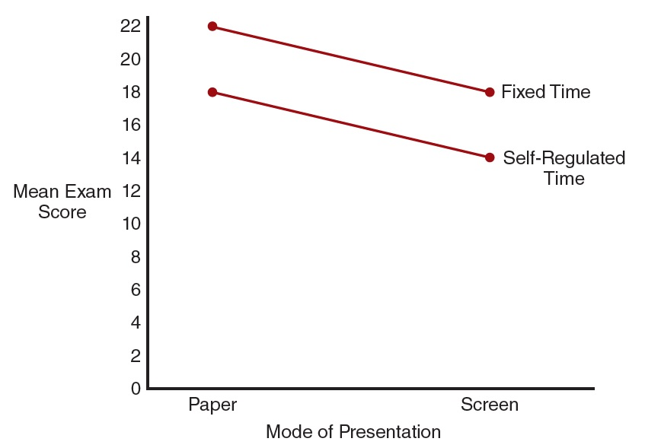
A Line Graph Indicating No Interaction
Notes:
Figure 11.2 A Line Graph of the Data from Table 11.2

Slide 10
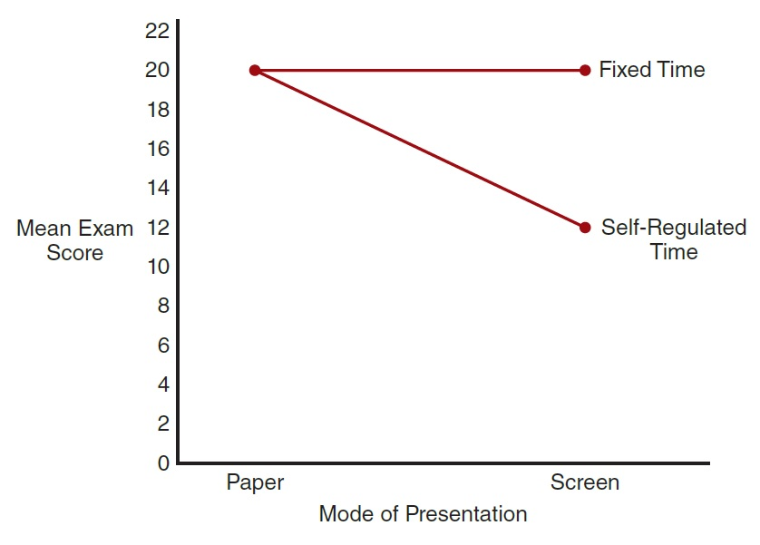
A Line Graph Indicating Interaction
Notes:
Figure 11.3 A Line Graph of the Data from Table 11.3
The hypothetical data are structured to show main effects for both factors and an interaction.

Slide 11
Interpreting Main Effects and Interactions
Significant effects indicated by a statistical analysis ► be careful about interpreting the outcome.
  Main effects may present a distorted view of the actual outcome.
    Each main effect is an average—it may not accurately represent any of the individual effects that were used to compute the average.

Slide 12
Independence of Main Effects and Interactions
The two-factor study allows researchers to evaluate three separate sets of mean differences:
  The mean differences from the main effect of factor A
  The mean differences from the main effect of factor B
  The mean differences from the interaction between factors

Slide 13
Types of Factorial Designs and Analysis
Between-subjects
  Requires a large number of participants
  Individual differences can become confounding variables.
  Avoids order effects

Slide 14
Between-Subjects and Within-Subjects Design
Within-subjects
  Each participant must undergo a high number of treatments.
    Time consuming and contributed to attrition
    Also increases risk of testing effects
  Require only one group of participants
  Eliminates problems with individual differences

Slide 15
Mixed Designs
Mixed designs: within- and between-subjects
  A mixed design: a factorial study that combines two different research designs.
    Used when one factor is expected to threaten validity
  A common example of a mixed design is a factorial study with one between-subjects factor and one within-subjects factor.

Slide 16
Experimental and Nonexperimental or Quasi-Experimental Research Strategies
A factorial study that is a purely experimental research design
  Both factors are true independent variables that are manipulated by the researcher.
A factorial study for which all the factors are nonmanipulated, quasi-independent variables.
  Note: the nonmanipulated variables are still called factors.

Slide 17
Combined Strategies
Uses two different research strategies in the same factorial design
  One factor is a true IV (experimental strategy).
  The second factor is a quasi-independent variable (nonexperimental or quasi-experimental strategy).
    Falls into one of the following categories: a preexisting participant characteristic or time

Slide 18
Pretest–Posttest Control Group Designs
 | Pretest | Posttest
Treatment Group | Pretest scores for participants who receive the treatment | Posttest scores for participants who receive the treatment
Control Group | Pretest scores for participants who do not receive the treatment | Posttest scores for participants who do no receive the treatment
Notes:
Figure 11.8 The Structure of a Pretest–Posttest Control Group Study Organized as a Two-Factor Research Design
Notice that the treatment/control factor is a between-subjects factor and the pre-post factor is a within-subjects factor.

Slide 19
Statistical Analysis of Factorial Designs
Depends partly on whether the factors are:
  Between-subjects
  Within-subjects
  Some mixture of between- and within-subjects
The standard practice includes:
  Computing the mean for each treatment condition (cell) and
  Using ANOVA to evaluate the statistical significance of the mean differences

Slide 20
Applications of Factorial Designs
Expanding and replicating a previous study
  Replication: repeating the previous study by using the same factor or IV exactly as it was used in the earlier study
  Expansion: adding a second factor in the form of new conditions or new participant characteristics
    Ascertain whether previously reported effects can be generalized to new situations/new populations

Slide 21
Evaluating Order Effects in Within-Subjects Design
Using the Order of Treatments as a Second Factor
  Makes it possible to evaluate any order effects that exist in the data
  There are three possible outcomes that can occur:
    No order effects
    Symmetrical order effects
    Nonsymmetrical order effect

